Slide 1
Department of CSE Batch No: 6
A Driving Decision Strategy based on
Machine learning for Autonomous vehicle
Team Members: Under the esteemed guidance of
B. Venkata Bhargav (217R1A0509) Mr.K.Praveen Kumar
T. Madhu (217R1A0556) Assistant Professor
M. Abhishek (217R1A0536)

Slide 2
Introduction
Currently, global companies are developing technologies for advanced self-driving cars, which is in the 4th stage.
Self-driving cars are being developed based on various ICT technologies, and the principle of operation can be
classified into three levels recognition, judgment, and control.
The recognition step is to recognize and collect information about surrounding situations by utilizing various sensors in vehicles such as GPS, camera, and radar.
The judgment step determines the driving strategy based on the recognized information.
Then, this step identifies and analyzes the conditions in which the vehicle is placed, and determines the driving plans appropriate to the driving environment and the objectives.
The control step determines the speed, direction, etc. of the driving and the vehicle starts driving on its own. An autonomous driving vehicle performs various actions to arrive at its destination, repeating the steps of recognition, judgment, and control on its own.

Slide 3
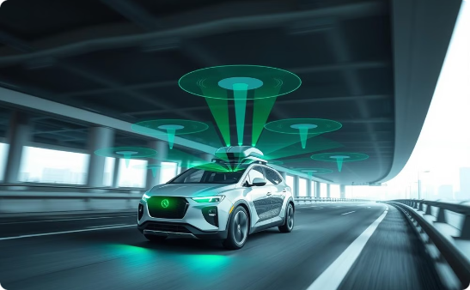
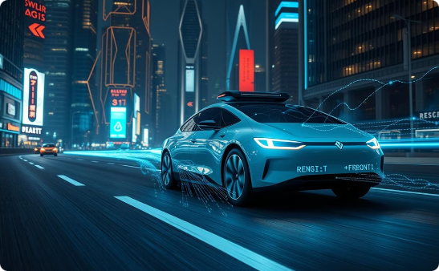
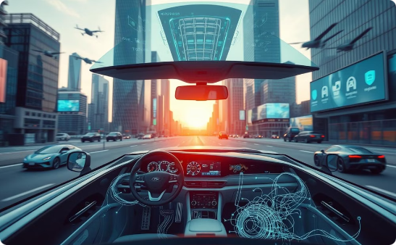
Existing System
Recognition
Judgement
Control
Vehicles use sensors such as GPS, cameras, and radar to gather information about the environment.
Based on sensor data, the vehicle determines the optimal driving strategy.
The vehicle executes the driving plan autonomously after analysis.
The "driving decision strategy using machine learning for an autonomous vehicle" system enables autonomous driving decisions using real-time machine learning algorithms
A machine learning model uses the pre-processed data to learn driving patterns and predict optimal decisions in various scenarios.
The decision-making module then translates these predictions into driving actions like steering, braking, or accelerating.

Slide 4
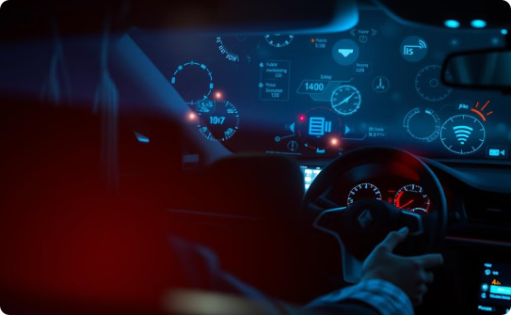
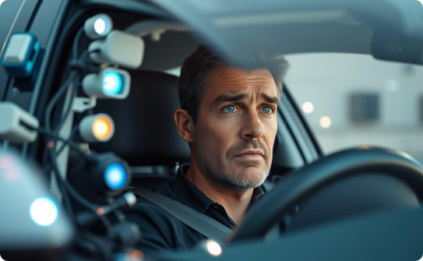
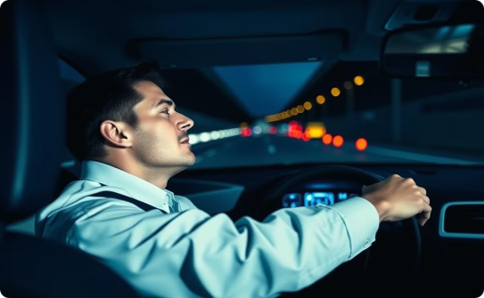
Disadvantages
Sensor Overload
Limited Focus on Internal Factors
Limited Adaptability
The numerous sensors used in autonomous vehicles generate large amounts of data, which can overload the vehicle's electrical system. This results in slower processing of data and reduced efficiency in judgment and control decisions​.
Existing systems primarily rely on external factors such as pedestrians, road conditions, GPS, and radar data for decision-making. They fail to consider internal vehicle conditions like RPM levels, steering angles, and overall vehicle health​.
Traditional rule-based systems rely on fixed algorithms and decision rules, making them inflexible in handling novel or unexpected driving scenarios. They cannot adapt to dynamic conditions not explicitly programmed. This limitation often results in suboptimal performance.

Slide 5
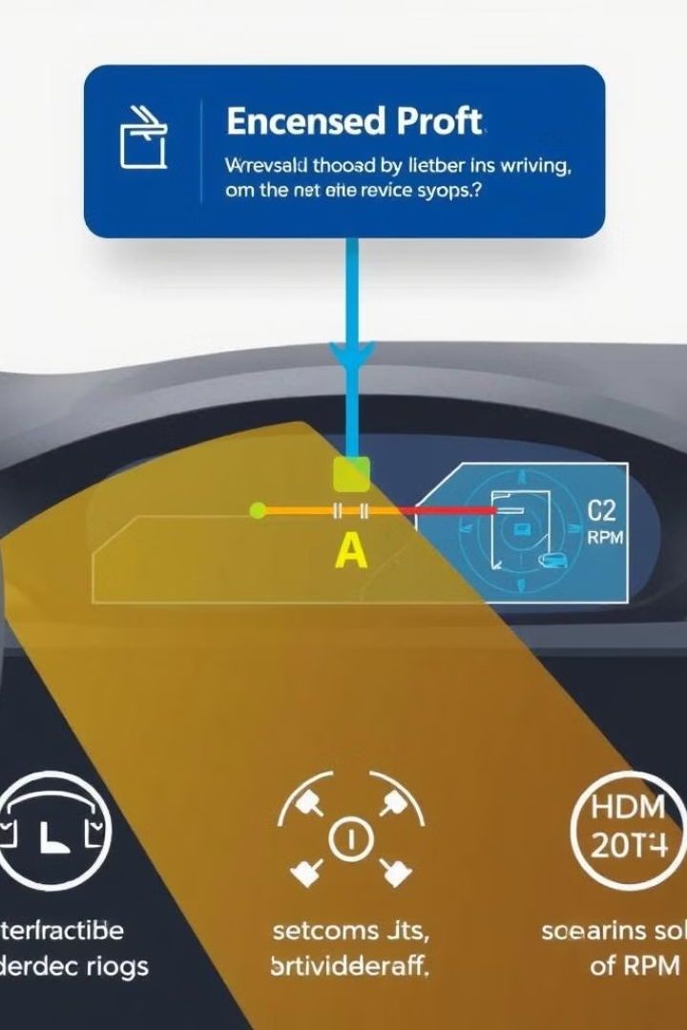
Proposed System
The Proposed System introduces a Driving Decision Strategy (DDS) that analyzes internal vehicle data like steering and RPM levels.
Existing systems primarily focus on external data, such as road conditions and pedestrians.
The proposed system improves decision-making by considering internal vehicle conditions for predicting driving actions.
Internal data, such as steering angle and speed, is gathered through sensors.
The application retrieves takes data and uses machine learning algorithms to make predictions.
This approach helps efficiently determine steering conditions and lane changes for better driving decisions.

Slide 6
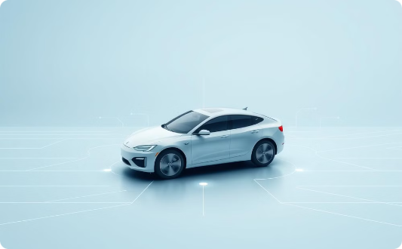
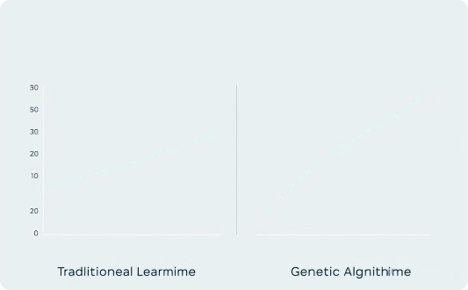
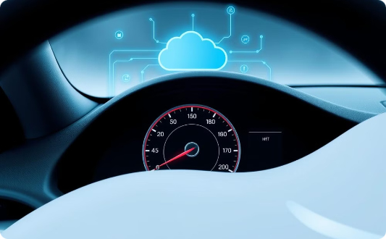
Advantages of Proposed System
Comprehensive Decision-Making
Improved Prediction Accuracy
Faster Processing
Genetic algorithms allow for faster and more efficient decision-making by optimizing input values from sensors​.
Considers internal factors (vehicle health, steering, RPM), leading to more accurate driving strategies.
The DDS, using a genetic algorithm, outperforms traditional machine learning models like Random Forest and MLP in terms of prediction accuracy​.

Slide 7
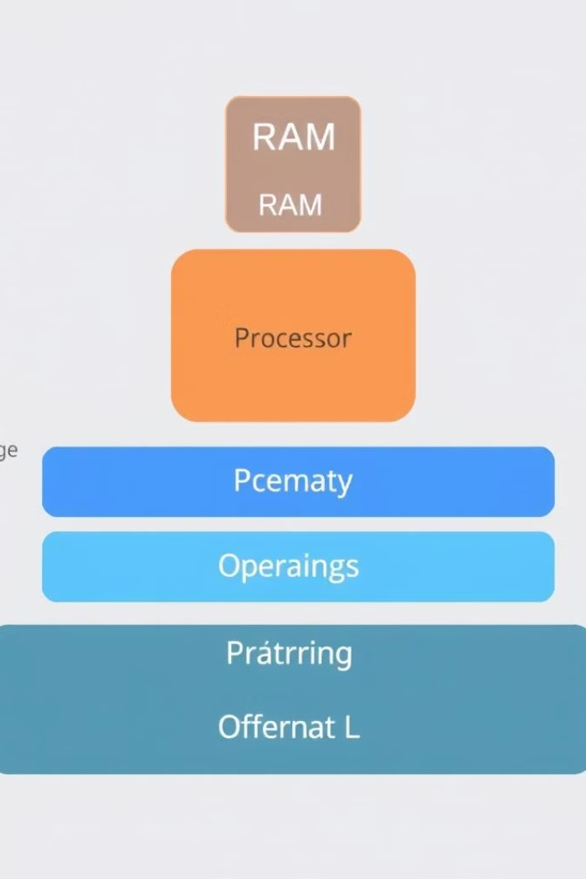
Hardware and Software Requirements
Hardware
System : i5 or above.
Ram : 8 GB
Hard Disk : 40 GB
Software
Operating system : Windows 8 or Above.
Coding Language : Python 3.0.7

Slide 8
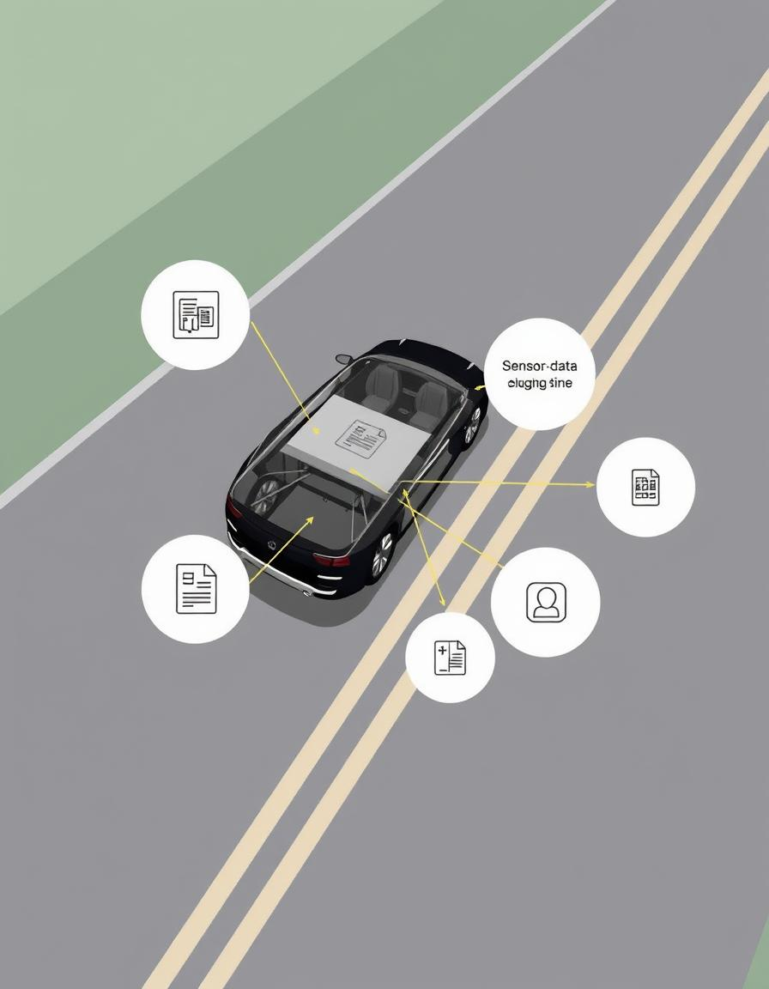
Novelty
Internal Data Focus: The system uniquely integrates internal vehicle data like RPM and steering angles, which are typically ignored in traditional autonomous driving strategies.
Driving Decision Strategy (DDS): Introduces a machine learning-based DDS that enhances decision-making for autonomous vehicles by using internal data.
Genetic Algorithm Optimization: Employs a genetic algorithm to select optimal values for faster and more accurate decision-making compared to traditional machine learning methods.
Internal and External Data Fusion: Combines both internal (e.g., RPM) and external (e.g., road conditions) data for a more comprehensive driving strategy.

Slide 9
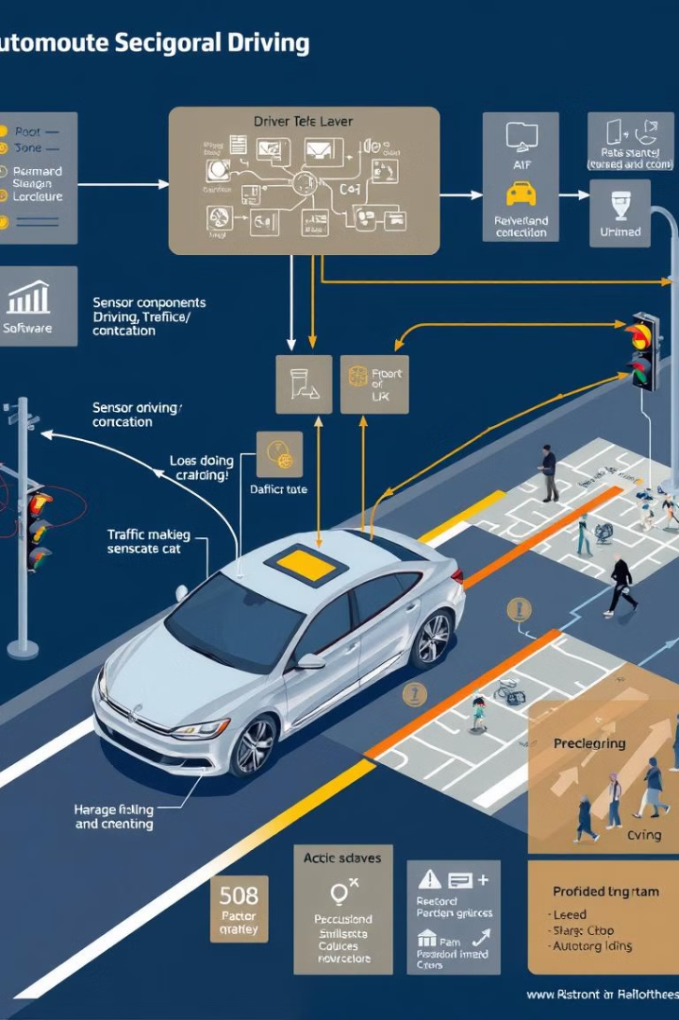
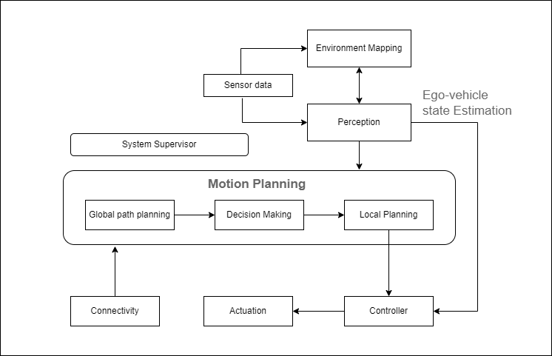
Architecture

Slide 10
Driving Decision Strategy Modules
Upload Historical Trajectory Dataset
Run MLP Algorithm
Predict DDS Type
Upload the dataset containing vehicle telemetry data including speed, RPM, lane change, and steering angle.
Train the Multi-Layer Perceptron (MLP) algorithm on the training data and calculate its prediction accuracy.
Use the trained DDS model to predict the driving decision types for the test data.
1
2
3
4
5
Generate Train & Test Model
Run DDS with Genetic Algorithm
Split the dataset into training and testing parts, then generate a machine learning model using the training data.
Train the Driving Decision Strategy (DDS) model using a Genetic Algorithm and evaluate its prediction accuracy.

Slide 11
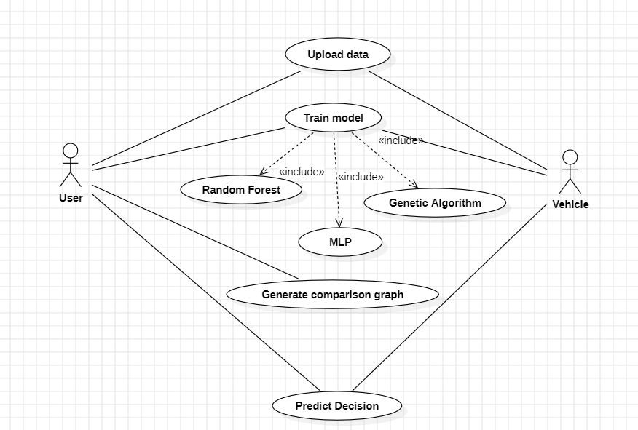
UML Diagrams
Use Case Diagram

Slide 12
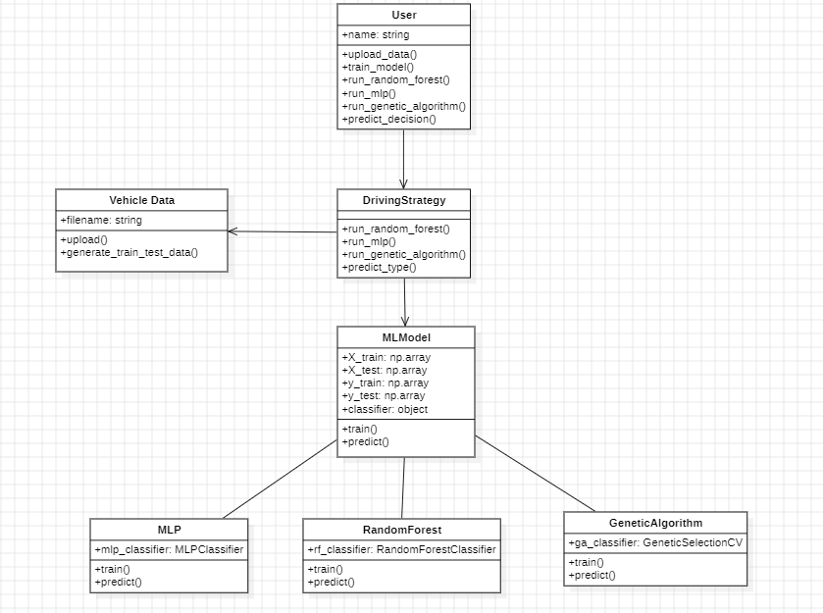
Class Diagram

Slide 13
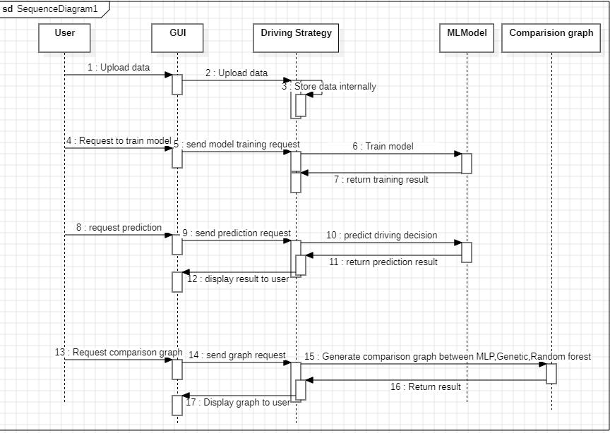
Sequence diagram

Slide 14
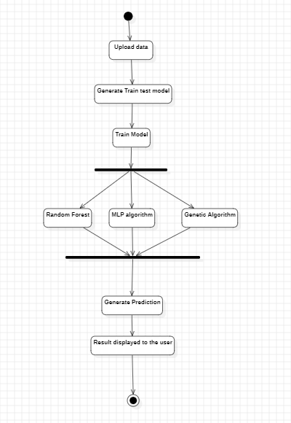
Activity diagram

Slide 15
Sample Code:
DDS.py
from tkinter import messagebox
from tkinter import *
from tkinter import simpledialog
import tkinter
from tkinter import filedialog
import matplotlib.pyplot as plt
import numpy as np
from tkinter.filedialog import askopenfilename
import pandas as pd
from sklearn.model_selection import train_test_split
from sklearn.metrics import accuracy_score
from sklearn.metrics import precision_score
from sklearn.metrics import recall_score
from sklearn.metrics import f1_score
from sklearn.neural_network import MLPClassifier
from sklearn.ensemble import RandomForestClassifier
from sklearn.preprocessing import LabelEncoder
from genetic_selection import GeneticSelectionCV
main = tkinter.Tk()
main.title("Driving Decision Strategy") #designing main screen
main.geometry("1300x1200")

Slide 16
global filename
global X
le = LabelEncoder()
global mlp_acc, rf_acc, dds_acc
global classifier
def upload(): #function to driving trajectory dataset
global filename
filename = filedialog.askopenfilename(initialdir="DrivingDataset")
text.delete('1.0', END)
text.insert(END,filename+" loaded\n")
def generateTrainTestData():
global X_train, X_test, y_train, y_test
text.delete('1.0', END)
train = pd.read_csv(filename)
train.drop('trajectory_id', axis=1, inplace=True)
train.drop('start_time', axis=1, inplace=True)
train.drop('end_time', axis=1, inplace=True)
print(train)
train['labels'] = pd.Series(le.fit_transform(train['labels']))
rows = train.shape[0] # gives number of row count
cols = train.shape[1] # gives number of col count
features = cols – 1
print(features)
X = train.values[:, 0:features]
Y = train.values[:, features]

Slide 17
print(Y)
X_train, X_test, y_train, y_test = train_test_split(X, Y, test_size = 0.2, random_state = 42)
text.insert(END,"Dataset Length : "+str(len(X))+"\n");
text.insert(END,"Splitted Training Length : "+str(len(X_train))+"\n");
text.insert(END,"Splitted Test Length : "+str(len(X_test))+"\n\n");
def prediction(X_test, cls): #prediction done here
y_pred = cls.predict(X_test)
for i in range(len(X_test)):
print("X=%s, Predicted=%s" % (X_test[i], y_pred[i]))
return y_pred
# Function to calculate accuracy
def cal_accuracy(y_test, y_pred, details):
accuracy = accuracy_score(y_test,y_pred)*100
text.insert(END,details+"\n\n")
text.insert(END,"Accuracy : "+str(accuracy)+"\n\n")
return accuracy
def runRandomForest():
global rf_acc
global classifier
text.delete('1.0', END)
rfc = RandomForestClassifier(n_estimators=2, random_state=0)
rfc.fit(X_train, y_train)
text.insert(END,"Random Forest Prediction Results\n")

Slide 18
prediction_data = prediction(X_test, rfc)
random_precision = precision_score(y_test, prediction_data,average='macro') * 100
random_recall = recall_score(y_test, prediction_data,average='macro') * 100
random_fmeasure = f1_score(y_test, prediction_data,average='macro') * 100
rf_acc = accuracy_score(y_test,prediction_data)*100
text.insert(END,"Random Forest Precision : "+str(random_precision)+"\n")
text.insert(END,"Random Forest Recall : "+str(random_recall)+"\n")
text.insert(END,"Random Forest FMeasure : "+str(random_fmeasure)+"\n")
text.insert(END,"Random Forest Accuracy : "+str(rf_acc)+"\n")
classifier = rfc
def runMLP():
global mlp_acc
text.delete('1.0', END)
cls = MLPClassifier(random_state=1, max_iter=10)
cls.fit(X_train, y_train)
text.insert(END,"Multilayer Perceptron Classifier (MLP) Prediction Results\n")
prediction_data = prediction(X_test, cls)
mlp_precision = precision_score(y_test, prediction_data,average='macro') * 100
mlp_recall = recall_score(y_test, prediction_data,average='macro') * 100
mlp_fmeasure = f1_score(y_test, prediction_data,average='macro') * 100
mlp_acc = accuracy_score(y_test,prediction_data)*100
text.insert(END,"Multilayer Perceptron Precision : "+str(mlp_precision)+"\n")
text.insert(END,"Multilayer Perceptron Recall : "+str(mlp_recall)+"\n")
text.insert(END,"Multilayer Perceptron FMeasure : "+str(mlp_fmeasure)+"\n")
text.insert(END,"Multilayer Perceptron Accuracy : "+str(mlp_acc)+"\n")

Slide 19
def runDDS():
global classifier
global dds_acc
dds = RandomForestClassifier(n_estimators=45, random_state=42)
selector = GeneticSelectionCV(dds, #algorithm name
cv=5,
verbose=1,
scoring="accuracy",
max_features=5,
n_population=10, #population
crossover_proba=0.5, #cross over
mutation_proba=0.2,
n_generations=50,
crossover_independent_proba=0.5,
mutation_independent_proba=0.05, #mutation
tournament_size=3,
n_gen_no_change=5,
caching=True,
n_jobs=-1)
selector = selector.fit(X_train, y_train)
text.insert(END,"DDS Prediction Results\n")
prediction_data = prediction(X_test, selector)
dds_precision = precision_score(y_test, prediction_data,average='macro') * 100
dds_recall = recall_score(y_test, prediction_data,average='macro') * 100
dds_fmeasure = f1_score(y_test, prediction_data,average='macro') * 100
dds_acc = accuracy_score(y_test,prediction_data)*100

Slide 20
text.insert(END,"DDS Precision : "+str(dds_precision)+"\n")
text.insert(END,"DDS Recall : "+str(dds_recall)+"\n")
text.insert(END,"DDS FMeasure : "+str(dds_fmeasure)+"\n")
text.insert(END,"DDS Accuracy : "+str(dds_acc)+"\n")
classifier = selector
def graph():
height = [rf_acc, mlp_acc,dds_acc]
bars = ('Random Forest Accuracy','MLP Accuracy','DDS with Genetic Algorithm Accuracy')
y_pos = np.arange(len(bars))
plt.bar(y_pos, height)
plt.xticks(y_pos, bars)
plt.show()
def predictType():
filename = filedialog.askopenfilename(initialdir="DrivingDataset")
text.delete('1.0', END)
text.insert(END,filename+" loaded\n");
test = pd.read_csv(filename)
test.drop('trajectory_id', axis=1, inplace=True)
test.drop('start_time', axis=1, inplace=True)
test.drop('end_time', axis=1, inplace=True)
cols = test.shape[1]
test = test.values[:, 0:cols]
predict = classifier.predict(test)
print(predict)

Slide 21
for i in range(len(test)):
if predict[i] == 0:
text.insert(END,str(test[i])+" : Decision Strategy is : Lane Change\n")
if predict[i] == 1:
text.insert(END,str(test[i])+" : Decision Strategy is : Speed\n")
if predict[i] == 2:
text.insert(END,str(test[i])+" : Decision Strategy is : Steering Angle\n")
font = ('times', 16, 'bold')
title = Label(main, text='A Driving Decision Strategy(DDS) Based on Machine learning for an autonomous vehicle')
title.config(bg='darkviolet', fg='gold')
title.config(font=font)
title.config(height=3, width=120)
title.place(x=0,y=5)
font1 = ('times', 12, 'bold')
text=Text(main,height=20,width=150)
scroll=Scrollbar(text)
text.configure(yscrollcommand=scroll.set)
text.place(x=50,y=120)
text.config(font=font1)
font1 = ('times', 14, 'bold')
uploadButton = Button(main, text="Upload Historical Trajectory Dataset", command=upload)
uploadButton.place(x=10,y=550)
uploadButton.config(font=font1)

Slide 22
trainButton = Button(main, text="Generate Train & Test Model", command=generateTrainTestData)
trainButton.place(x=380,y=550)
trainButton.config(font=font1)
rfButton = Button(main, text="Run Random Forest Algorithm", command=runRandomForest)
rfButton.place(x=720,y=550)
rfButton.config(font=font1)
mlpButton = Button(main, text="Run MLP Algorithm", command=runMLP)
mlpButton.place(x=10,y=600)
mlpButton.config(font=font1)
ddsButton = Button(main, text="Run DDS with Genetic Algorithm", command=runDDS)
ddsButton.place(x=380,y=600)
ddsButton.config(font=font1)
graphButton = Button(main, text="Accuracy Comparison Graph", command=graph)
graphButton.place(x=720,y=600)
graphButton.config(font=font1)
predictButton = Button(main, text="Predict DDS Type", command=predictType)
predictButton.place(x=1000,y=600)
predictButton.config(font=font1)
main.config(bg='sea green')
main.mainloop()

Slide 23
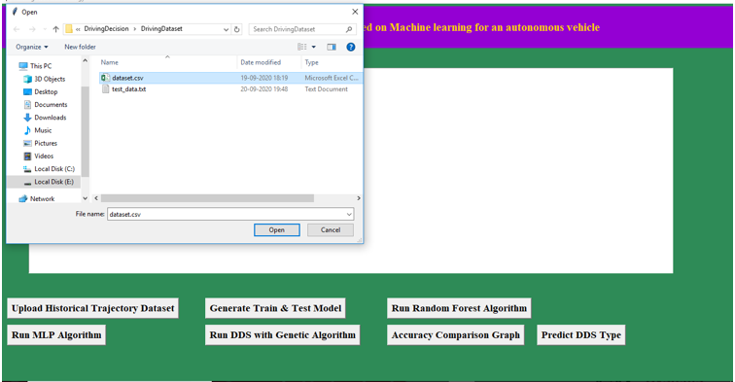
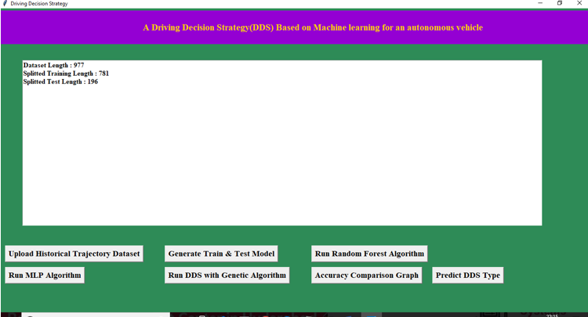
Result:
Figure 1:Data Upload Figure 2:Generate Train & Test Model

Slide 24
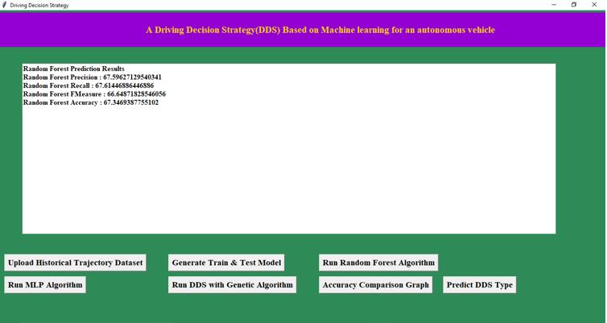
Attributes of Random Forest
Figure 3: Model Training with Random Forest Algorithm

Slide 25
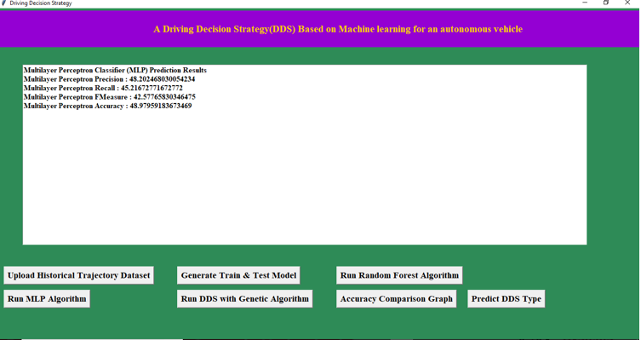
Attributes of MLP
Figure 4: Model Training using MLP

Slide 26
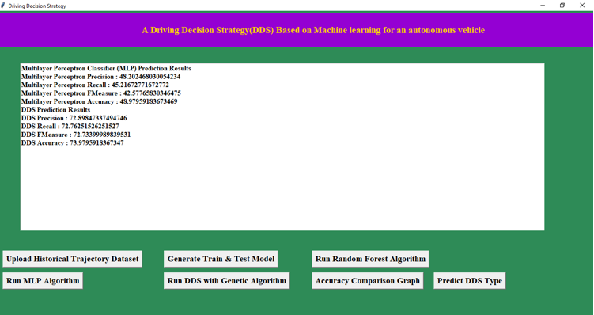
Genetic algorithm Attributes
Figure 5: Model Training using Genetic Algorithm

Slide 27
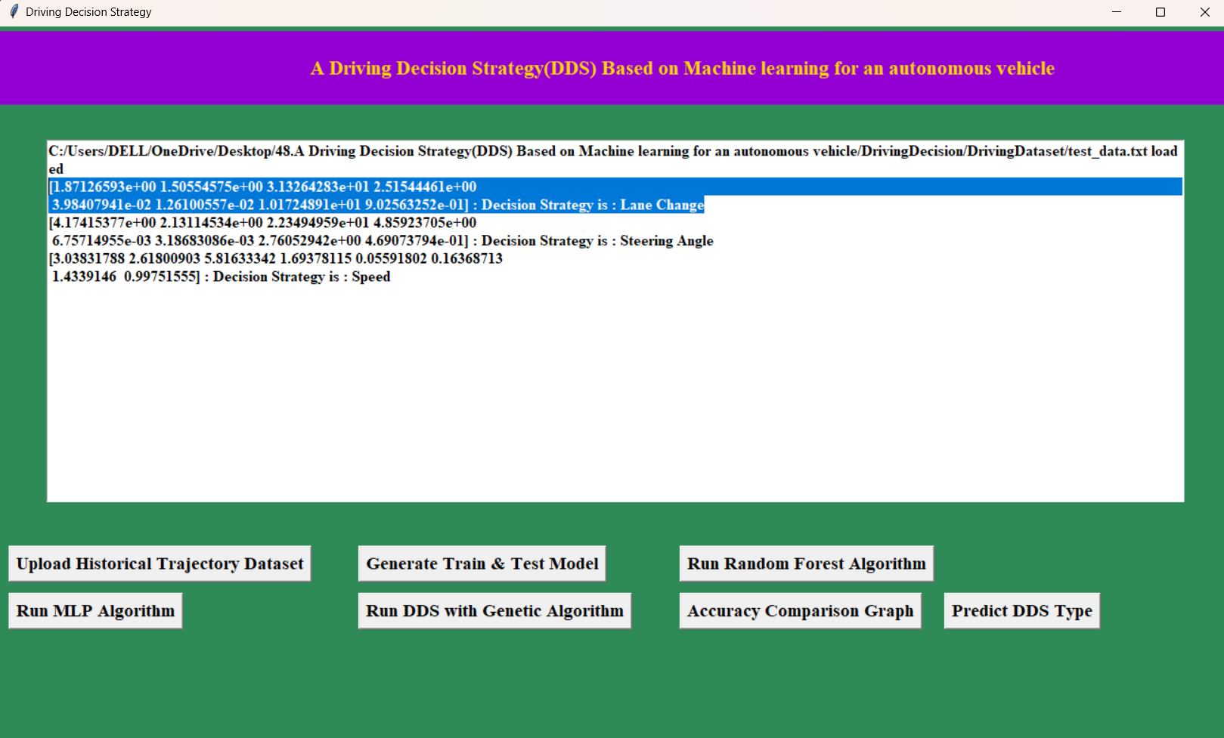
Prediction
Figure 6: Predicting Result

Slide 28
Conclusion
1. The Driving Decision Strategy (DDS) executes a genetic algorithm using accumulated data to determine the optimal driving strategy based on road slope and curvature.
2. The DDS visualizes driving conditions and consumables of an autonomous vehicle, offering a clear interface for drivers.
3. Experiments conducted on the Desoto autonomous vehicle validated the DDS by selecting optimal driving strategies based on vehicle data analysis.
4. The DDS matched the accuracy of the Multi-Layer Perceptron (MLP) model but determined the optimal strategy 40% faster.
5. The DDS outperformed Random Forest (RF) by achieving 22% higher accuracy and determining driving strategies 20% faster.

Slide 29
Future Scope
The future scope of the Driving Decision Strategy (DDS) project is promising, with
numerous avenues for advancement.
Enhancing data integration from various sensors, such as LiDAR and cameras, can significantly improve the system's situational awareness.
Additionally, incorporating real-time learning capabilities would allow the DDS to adapt dynamically to new driving conditions.
Exploring vehicle-to-everything (V2X) communication can further enhance safety and efficiency by facilitating information sharing among vehicles and infrastructure.
Overall, the DDS can evolve to address regulatory frameworks, public acceptance, and optimization for fleet management, paving the way for more reliable and effective autonomous vehicle systems.

Slide 30
References
Y.N. Jeong, S.R.Son, E.H. Jeong and B.K. Lee, "An Integrated Self-Diagnosis System for an Autonomous Vehicle Based on an IoT Gateway and Deep Learning," Applied Sciences, vol. 8, no. 7, July 2018.
Yukiko Kenmochi, Lilian Buzer, Akihiro Sugimoto, Ikuko Shimizu, "Discrete plane segmentation and estimation from a point cloud using local geometric patterns, "International Journal of Automation and Computing, Vol. 5, No. 3, pp746-256, 2008.
Ning Y e, Yingya Zhang, Ruchuan Wang, Reza Malekian, "Vehicle trajectory prediction based on Hidden Markov Model, " The KSII Transactions on Internet and Information Systems, Vol. IO, No. 7, 2017.
Li-Jie Zhao, Tian-You Chai, De-Cheng Yuan, "Selective ensemble extreme learning machine modeling of effluent quality in wastewater treatment plants, " International Journal of Automation and Computing, Vol.9, No.6, 2012

Slide 31
Github Link:
https://github.com/Bhargav3000/A-Driving-Decision-Strategy-based-on-Machine-Learning-for-Autonomous-vehicle

Slide 32

Thank you
By Batch 6
CSE

